Slide 1
Human Resource Development
Ms. Sonali Shugani

Slide 2
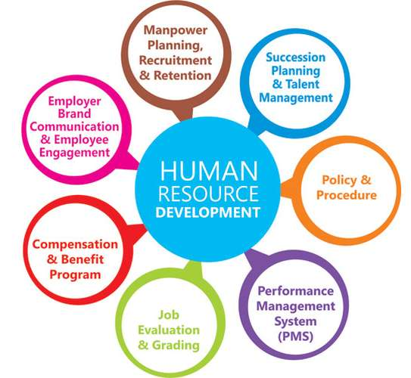
Introduction
Human Resource Development (HRD) is that part of Human Resource Management which specifically deals with the training and development of employees. It helps the employees in developing their knowledge, skills and abilities to achieve self-fulfillment and aid in the accomplishment of organizational goals.

Slide 3
MEANING OF HRD
HRD is "the process of increasing the knowledge, the skills, and the capacities of all the people in a society. In economic terms, it could be described as the accumulation of human capital and its effective investment in the development of an economy. In political terms, human resource development prepares people for adult participation in political processes, particularly as citizens in a democracy. From the social and cultural points of view, the development of human resources helps people to lead fuller and richer lives, less bound by tradition. In short, the processes of human resource development unlock the door to modernization.

Slide 4
EVOLUTION of HRD
Development of “learning while doing” or “on the job training” methodology.
Need of welfare activities to improve the worker efficiency
Work place cleanliness and improvement
Focus on understanding the human need

Slide 5
One machine can do the work of fifty ordinary men. No machine can do the work of one extraordinary man.
“
”
ELBERT HUBBARD

Slide 6
Aims of HRD
Improve performance of individual on present job
Improve group dynamism and effectiveness
Integrate goal of individual with the goal of the organization
Optimize the available human resource in an organization
Encourage creativity
Provide opportunities and facilities to individual for full expression of their talent potential
Improve interpersonal relationship and work culture

Slide 7
Objectives of HRD
To provide equal opportunities to employees
Align HRD activities with business strategies
Upgrading the competencies of employees
Achieve competitive advantage

Slide 8
Distinction Between HRD and HRM
8

Slide 9
BENEFITS OF HRD
Enhancing the quality of work
Improving employee retention rates
Building production workplace relationships
Making it easier to implement change
Encouraging worklace collaboration

Slide 10
Principles of Human Resource Development( HRD)
Principle of Development of Organizational Capability
Principle of Implicit Maximization
Principle of Autonomy Maximization
Principle of Maximum delegation
Principle of Participative Decision- making
Principle of Change Management
Principle of Periodic Review

Slide 11
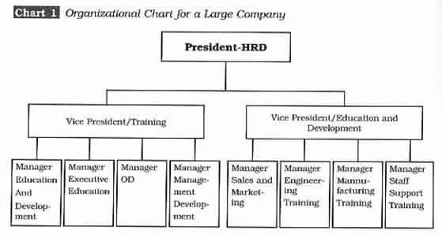
Structure of HRD System

Slide 12
Structure of hrd

Slide 13
Role of HRD Manpower
Talent Acquisition
Recruit and Select the right talent
Training and Development
Design and implement training programs
Performance management
Establish performance appraisal systems
Career Development
Assist in identifying career goals and progression

Slide 14
ROLE OF HRD MANPOWER
Employee Engagement
Foster a positive working environment
Succession Planning
Identify and develop future leaders
Change management
Facilitate organizational change
Employee relations
Mediate conflicts and address grievances

Slide 15
Management Development in HRD: Grooming Tomorrow's Leaders

Slide 16
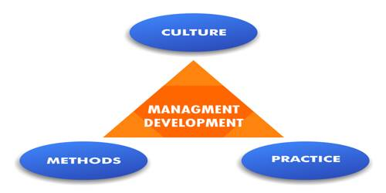
Definition of Management Development
In the opinion of Molander, “Management development is a conscious and systematic process to control the development of managerial resources in the organisation for the achievement of goals and strategies.”

Slide 17
Importance of Developing Effective Managers
Enhances Leadership Skills
Promotes Innovation
Builds High-Performing Teams
Cultivates Succession Planning
Fosters a Culture of Learning

Slide 18
Importance of Management Development
Management development fuels organizational growth.
It cultivates leadership talent for succession planning.
Improves employee engagement and retention.
Enhances decision-making capabilities.
Promotes adaptability and resilience.

Slide 19
Importance of Management Development
Strengthens organizational culture and values.
Increases customer satisfaction and loyalty.
Supports diversity and inclusion initiatives.
Adapts to technological advancements.
Drives innovation and competitiveness.

Slide 20
Methods/Techniques of management development
On-the-Job Methods
Job rotation and shadowing
Action learning projects
Special assignments and stretch projects
Feedback and performance appraisal
Off-the-Job Methods
Training programs
Coaching and mentoring
Executive education
Online learning platforms
Communities of practices

Slide 21
Job Rotation and Shadowing:
Cross-Functional Rotation: Managers rotate through different departments or functions within the organization to gain exposure to various aspects of the business.
Shadowing Senior Leaders: Managers shadow senior executives to observe their decision-making processes and leadership styles.

Slide 22
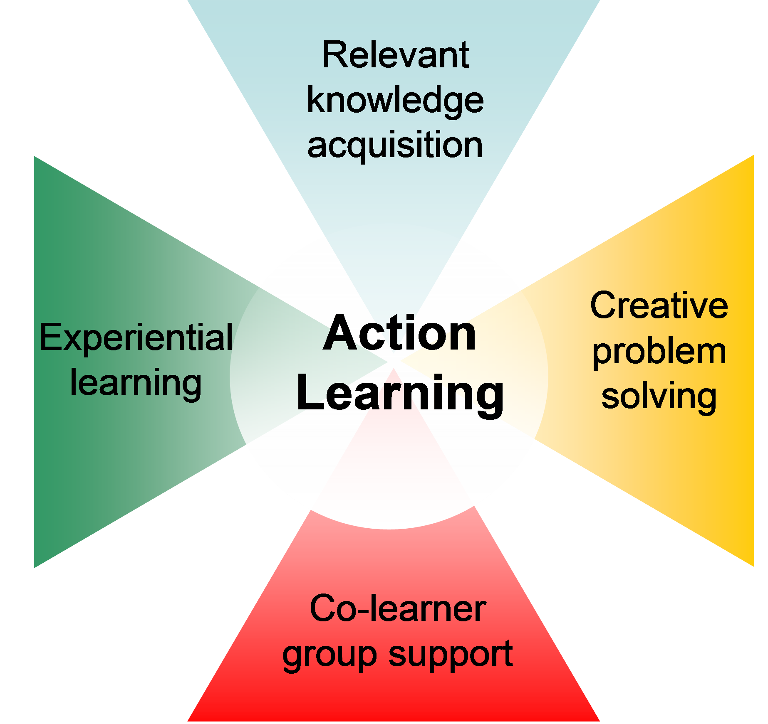
Action Learning Projects:
Real-World Projects: Assigning managers to lead or participate in cross-functional projects aimed at solving actual business problems.

Slide 23
Special Assignments and Stretch Projects:
Challenging Assignments: Offering managers opportunities to take on challenging projects or roles that stretch their capabilities.

Slide 24
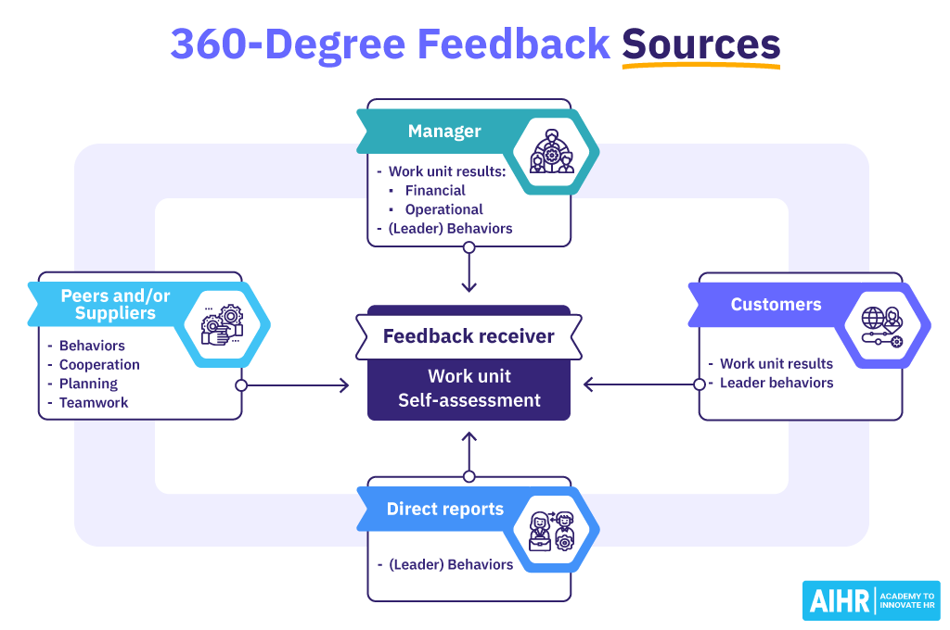
Feedback and Performance Appraisal:
360-Degree Feedback: Gathering feedback from multiple sources to provide managers with a comprehensive assessment of their performance.

Slide 25
Training Programs:
Workshops and Seminars: Short-duration sessions focusing on specific skills or topics such as communication and decision-making.
Skill-Based Training: Targeted programs to enhance technical or functional skills relevant to managerial roles.
Leadership Development Workshops: Programs designed to develop leadership competencies.

Slide 26
Coaching and Mentoring:
One-on-One Coaching: Individualized coaching sessions where managers receive personalized guidance and feedback.
Peer Mentoring: Pairing managers with more experienced peers to share insights and provide support.

Slide 27
Executive Education:
Formal Programs: Structured programs designed to develop leadership competencies at different managerial levels, often incorporating workshops, assessments, and coaching.
Specialized Courses: Partnering with academic institutions or specialized training providers to offer customized executive education programs tailored to the organization's needs.

Slide 28
Online Learning Platforms:
E-Learning Courses: Providing access to online courses, webinars, and virtual classrooms covering a wide range of topics related to management and leadership development.

Slide 29
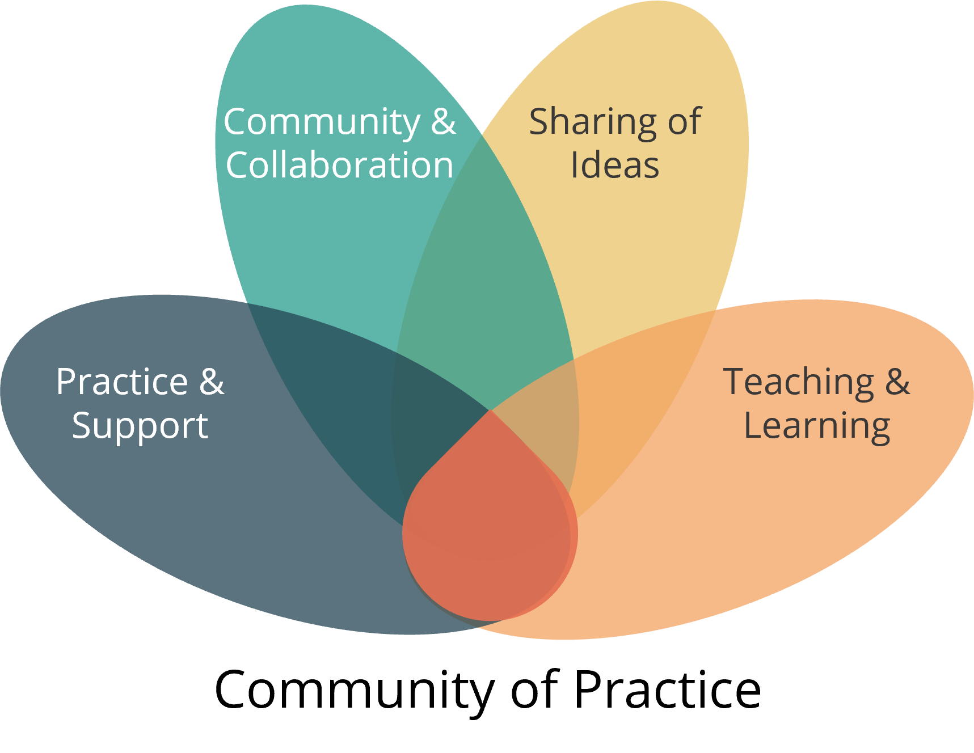
Communities of Practice:
Professional Networks: Facilitating networking opportunities and creating forums where managers can connect and share knowledge with peers in similar roles or industries.
Communities and Forums: Establishing online or offline communities of practice focused on specific areas such as leadership or innovation.

Slide 30
'If you cannot do great things, do small things in a great way.'
– NAPOLEON HILL

